Slide 1
S3 Vajra Vista Ground Rules
v1.0
05-Jan-2017

Slide 2

Why this document? Because…
I didn’t know that I had to do that…

Slide 3

Why this document? Because…
I didn’t do that…

Slide 4

Why this document? Because…
What are you talking about?...

Slide 5
Aim of the document
To reduce the confusion regarding who should do what, if not eliminate it
To address some of the problems faced
To divide some tasks in a way so that everyone contributes to the proper running of the house
To hold everyone accountable/responsible for maintenance of the house
To open a channel of communication between members

Slide 6
Points to be discussed
Cook
Cleanliness and Hygiene-Kitchen and General
Electricity
Water
Internet
Gas
Pollution
Appendix-I
Appendix-II

Slide 7
Version History
v1.0 – 05-Jan-2017
Next version here
Version | Date | Editor | Remarks
1.0 | 05-Jan-2017 | Sambit Sahoo | Initiation
Next v.

Slide 8
COOK
So that we may eat…

Slide 9
COOK
Cooking-who will eat how much?
Fetching the raw materials

Slide 10
COOK – Who will eat how much?
Everyone has to inform previously how much they’ll eat in the next meal.
If missing any meal, have to inform previously in the group.
Wastage should be minimized, so everyone has to cautious.

Slide 11
COOK - Fetching the raw materials
To be fetched in Round Robin sequence.
When any item is finished, it has to be updated in the group so that the next in RR sequence can buy it.
Adjustment can be done by mutual agreements.
After getting raw materials, store items in appropriate locations and dipose of the bags in dry dustbin.

Slide 12
CLEANLINESS & HYGIENE-Kitchen Hygiene
So that we don’t just live, we stay healthy…

Slide 13
Cleanliness and Hygiene-Kitchen Hygiene
Disposing of the leftovers
Maintaining hygiene while cooking
Cleaning utensils
Disposing of the garbage bins
Maintaining the basin
Kitchen cleaning

Slide 14
Kitchen Hygiene-Garbage bags disposal
Garbage bags to be fitted tightly to the garbage bin.
Should be replaced every two days.
Garbage bag disposal roster(alphabetical) to be maintained and updated regularly
Estimated time – 3 minutes
Dry bin separate from wet bin
Automated reminders to be sent regularly.
If unavailable, should inform the next one in the sequence(alphabetical) and do pending tasks when available.

Slide 15
How to dispose of Garbage from the Dustbin
Step 1: Collect
Collect the filled up garbage bag
Step 2: Replace
Tear one new bag from the roll
Step 3: Throw & Update
Throw the soiled bag in the designated place downstairs
Take it out of the dustbin
Open it and place it in dustbin so that it covers perfectly from all sides
Update your activity on the duty roster

Slide 16
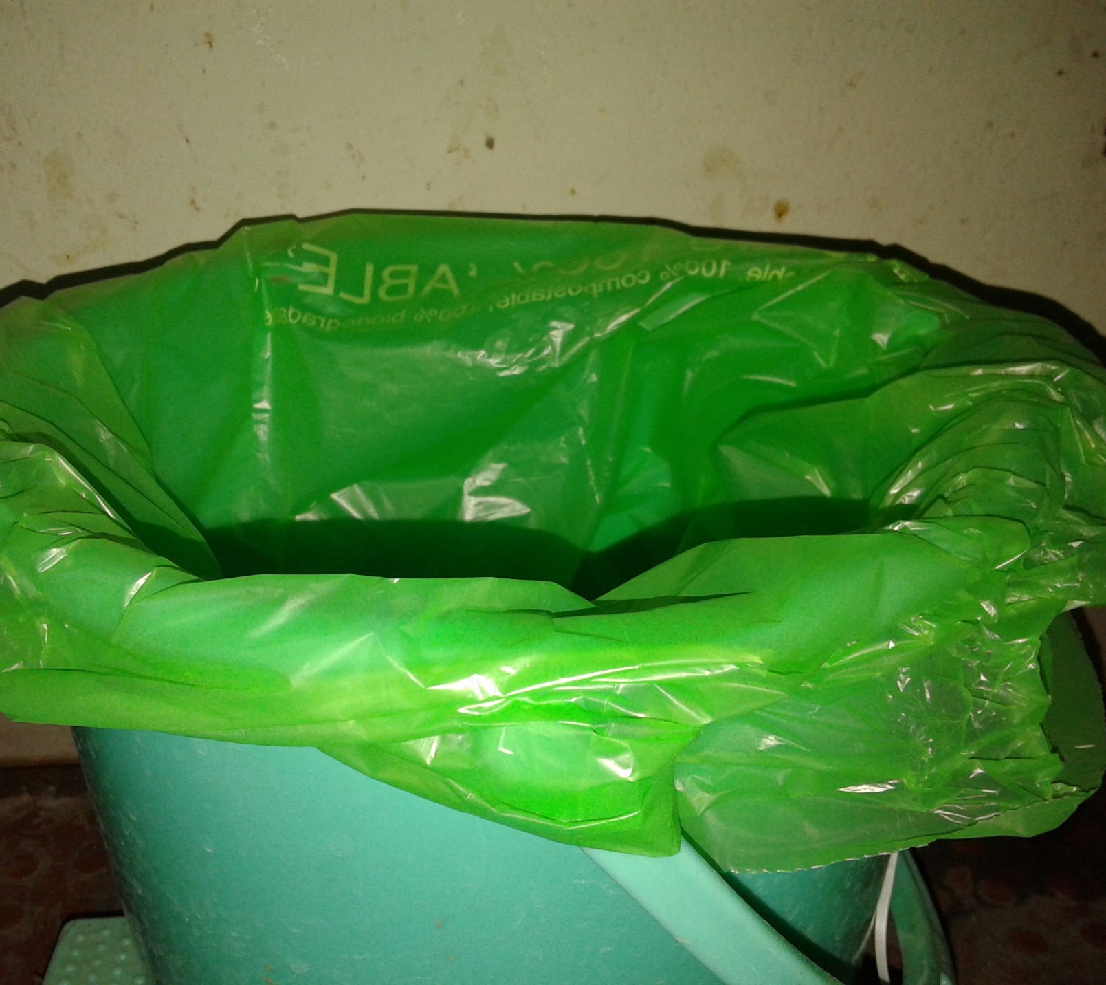
Dressing the bag
Covered from all sides

Slide 17
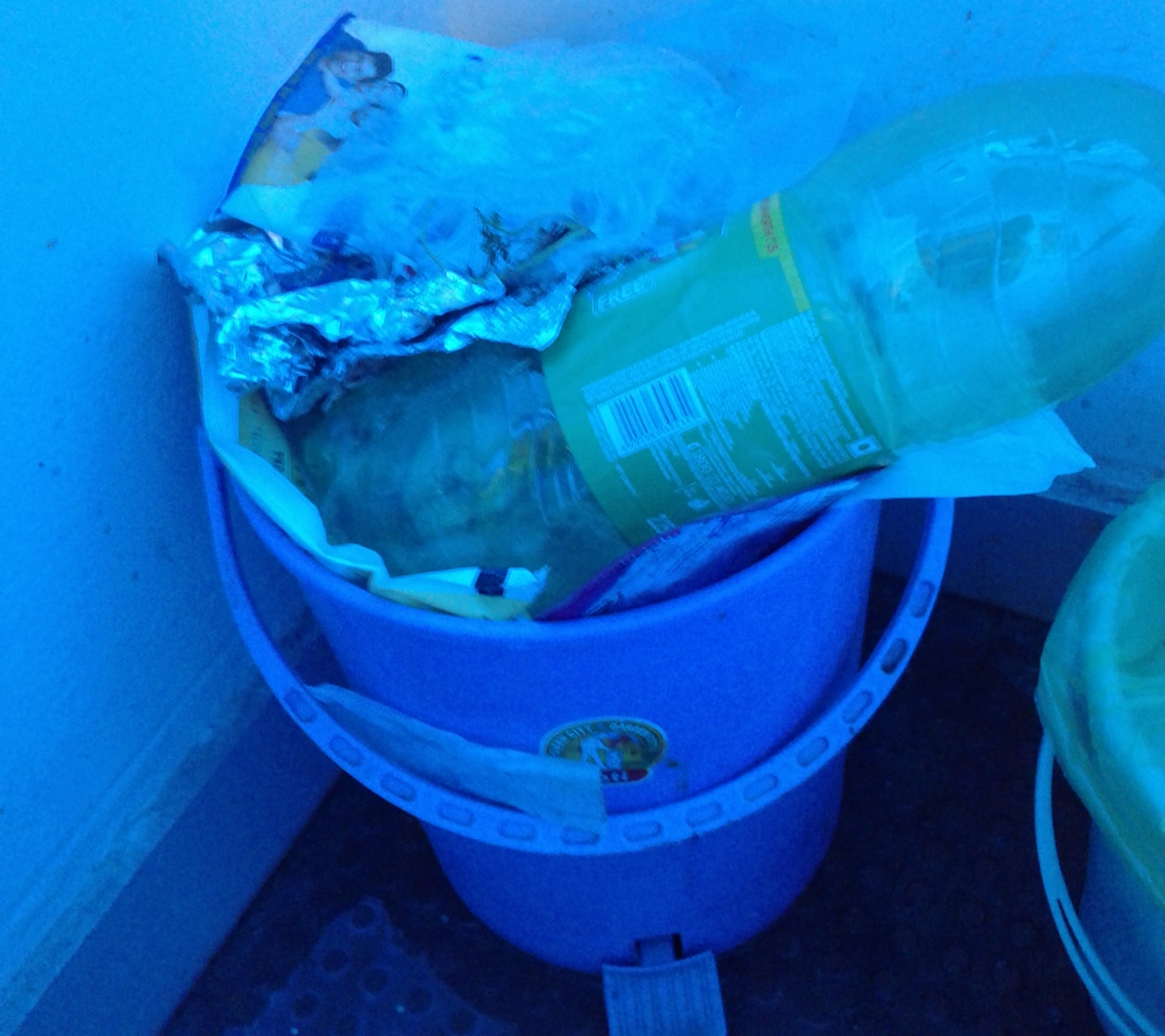
Garbage bag not covering
Disaster

Slide 18
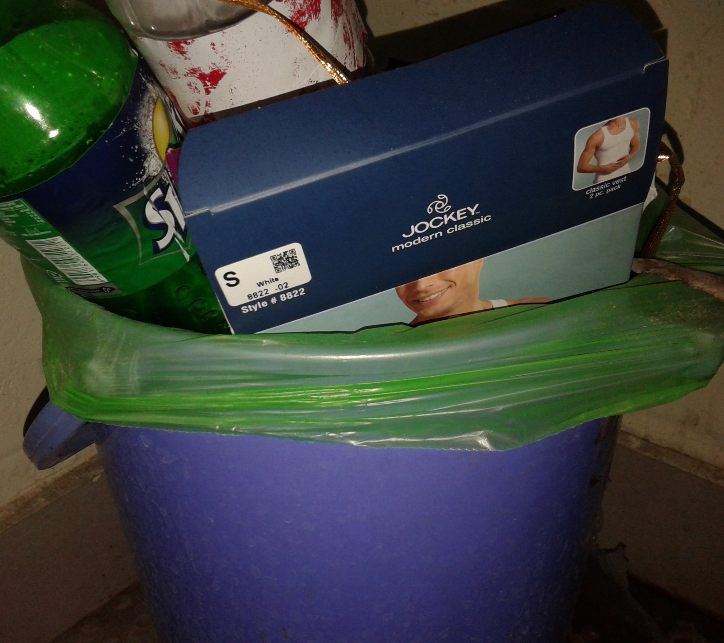
Garbage bag properly fit
Less worries now

Slide 19


Garbage bags disposal-Roster demo
Date | Name | /
06-Jan-2017 | Abhinav
08-Jan-2017 | Ankur
11-Jan-2017 | Gitesh
13-Jan-2017 | Pradeesh
15-Jan-2017 | Sambit

Slide 20
Kitchen Hygiene-Leftover disposal
Cook finds leftover -> throw in wet dustbin
We find leftover -> throw in wet dustbin
If disposable in the sink, then ok. Else dustbin.
Immediately after disposal
Clean the utensil

Slide 21
Kitchen Hygiene-Cooking Hygiene
Ensure utensils are clean
Ensure that vegetables etc. are washed and clean
Ensure knives, peelers etc. are cleaned before and after use
Ensure hands are clean

Slide 22
Kitchen Hygiene-Cleaning utensils & plates
If maid cleans -> put all utensils in the basin
If no maid -> cook* .
If no cook -> everyone has to lend a hand in cleaning.
Everyone has to clean their respective plates.
Utensil cleaning/basin cleaning duty roster to be maintained.
*current cook said that he’s not responsible for cleaning all utensils, he’s only cleaning required utensils so that he can cook food.

Slide 23
Kitchen Hygiene-Maintaining the basin
Responsibility of everyone using the kitchen sink.
Every week one has to take responsibility of cleaning the kitchen, which includes cleaning the gas stove, the cupboards(outside), the tiles and the kitchen sink.
No solid agents to be left in the plates/utensils added to the sink.
Ensure free flow of water.
Cleaning duty roster to be updated regularly and automated mails to be sent.
If unavailable, should inform the next one in the sequence(alphabetical) and do pending tasks when available.

Slide 24
Kitchen Hygiene-Kitchen Cleaning

Slide 25
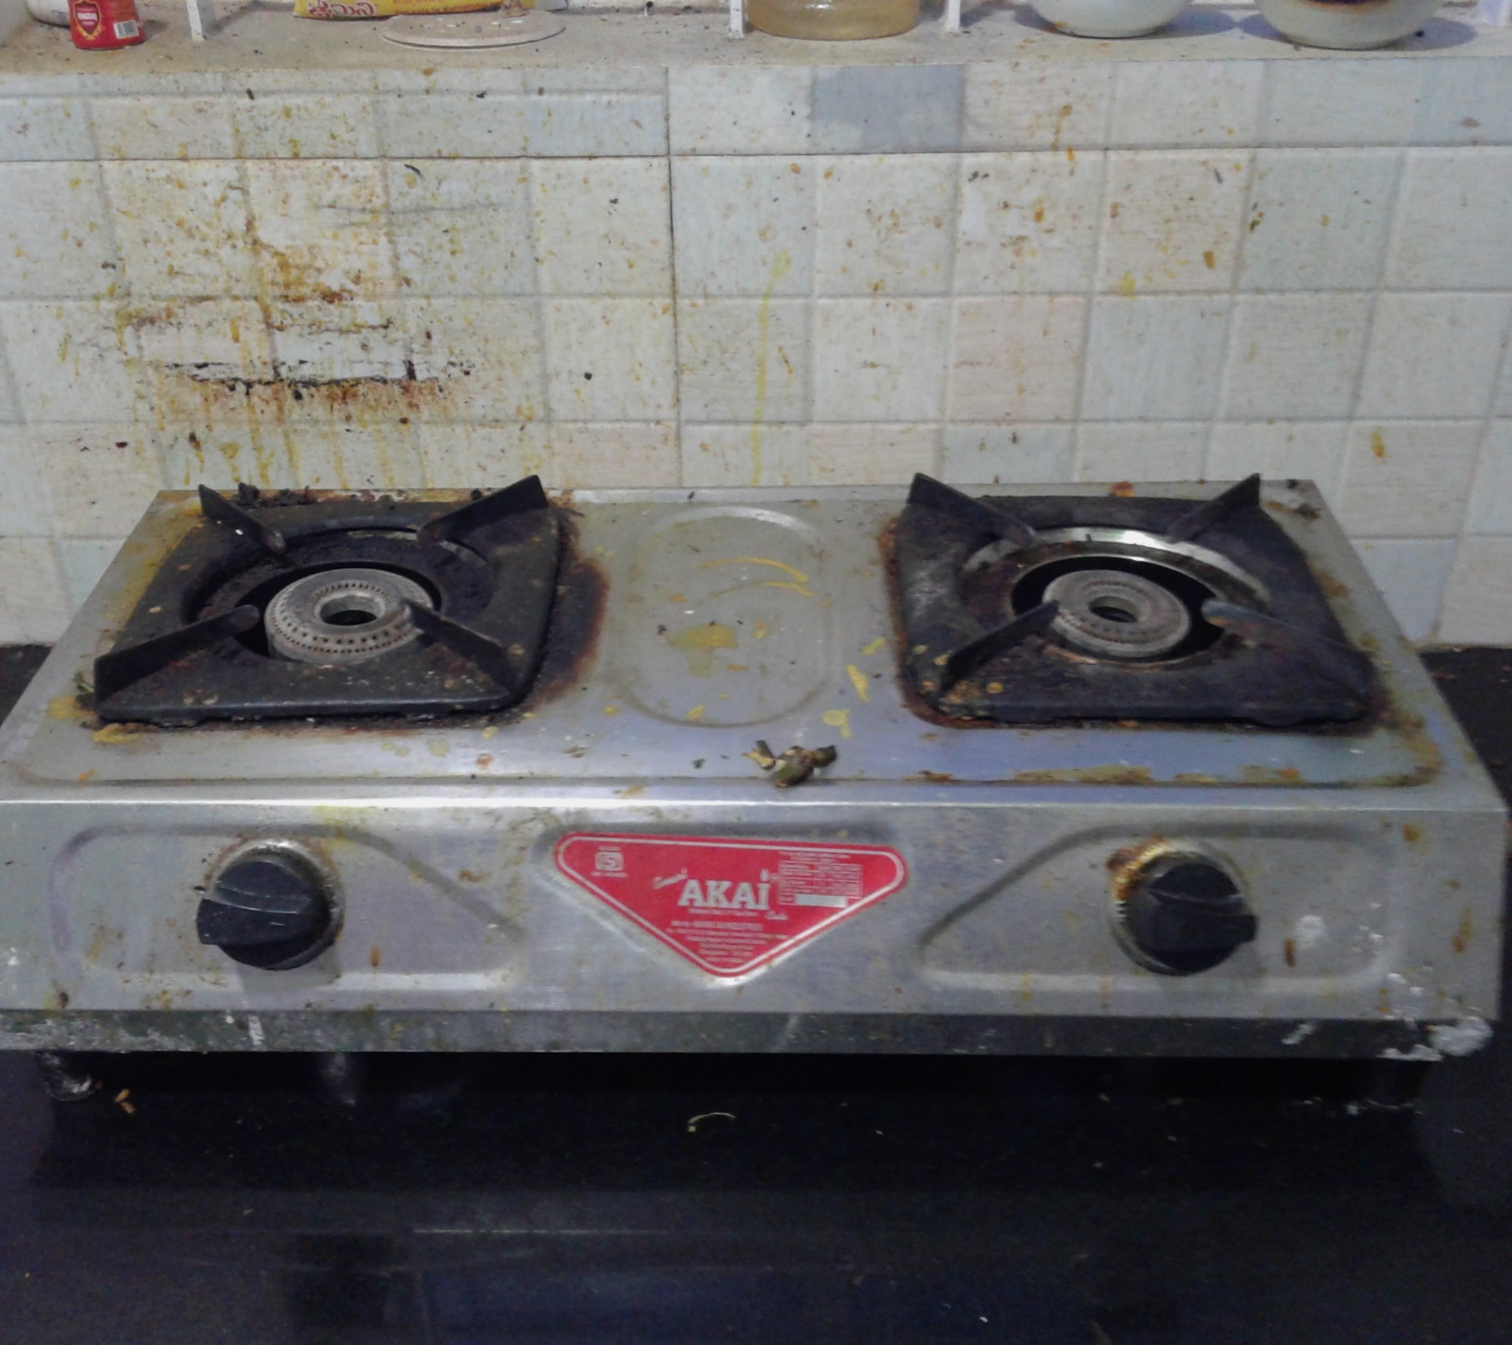
Is this good enough?
Would you like food cooked in such a stove in such a condition?

Slide 26
Kitchen Hygiene-Kitchen Cleaning
Once every week
Roster to be maintained and updated every week.
Automated reminder mails to be sent every week.
Places to be cleaned-gas stove, tiles, sink, cupboard(outside), table
Estimated time-10 minutes

Slide 27
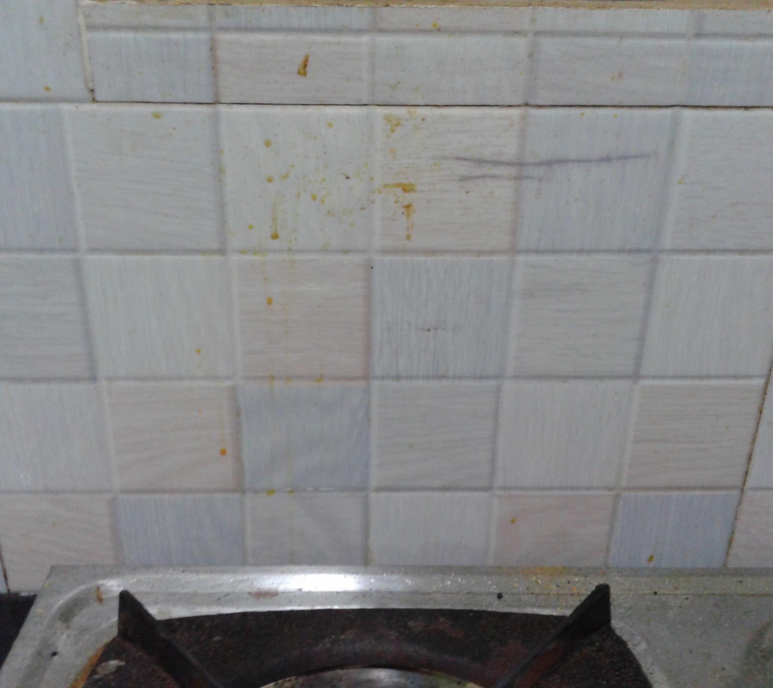
To be cleaned
Wall tiles

Slide 28
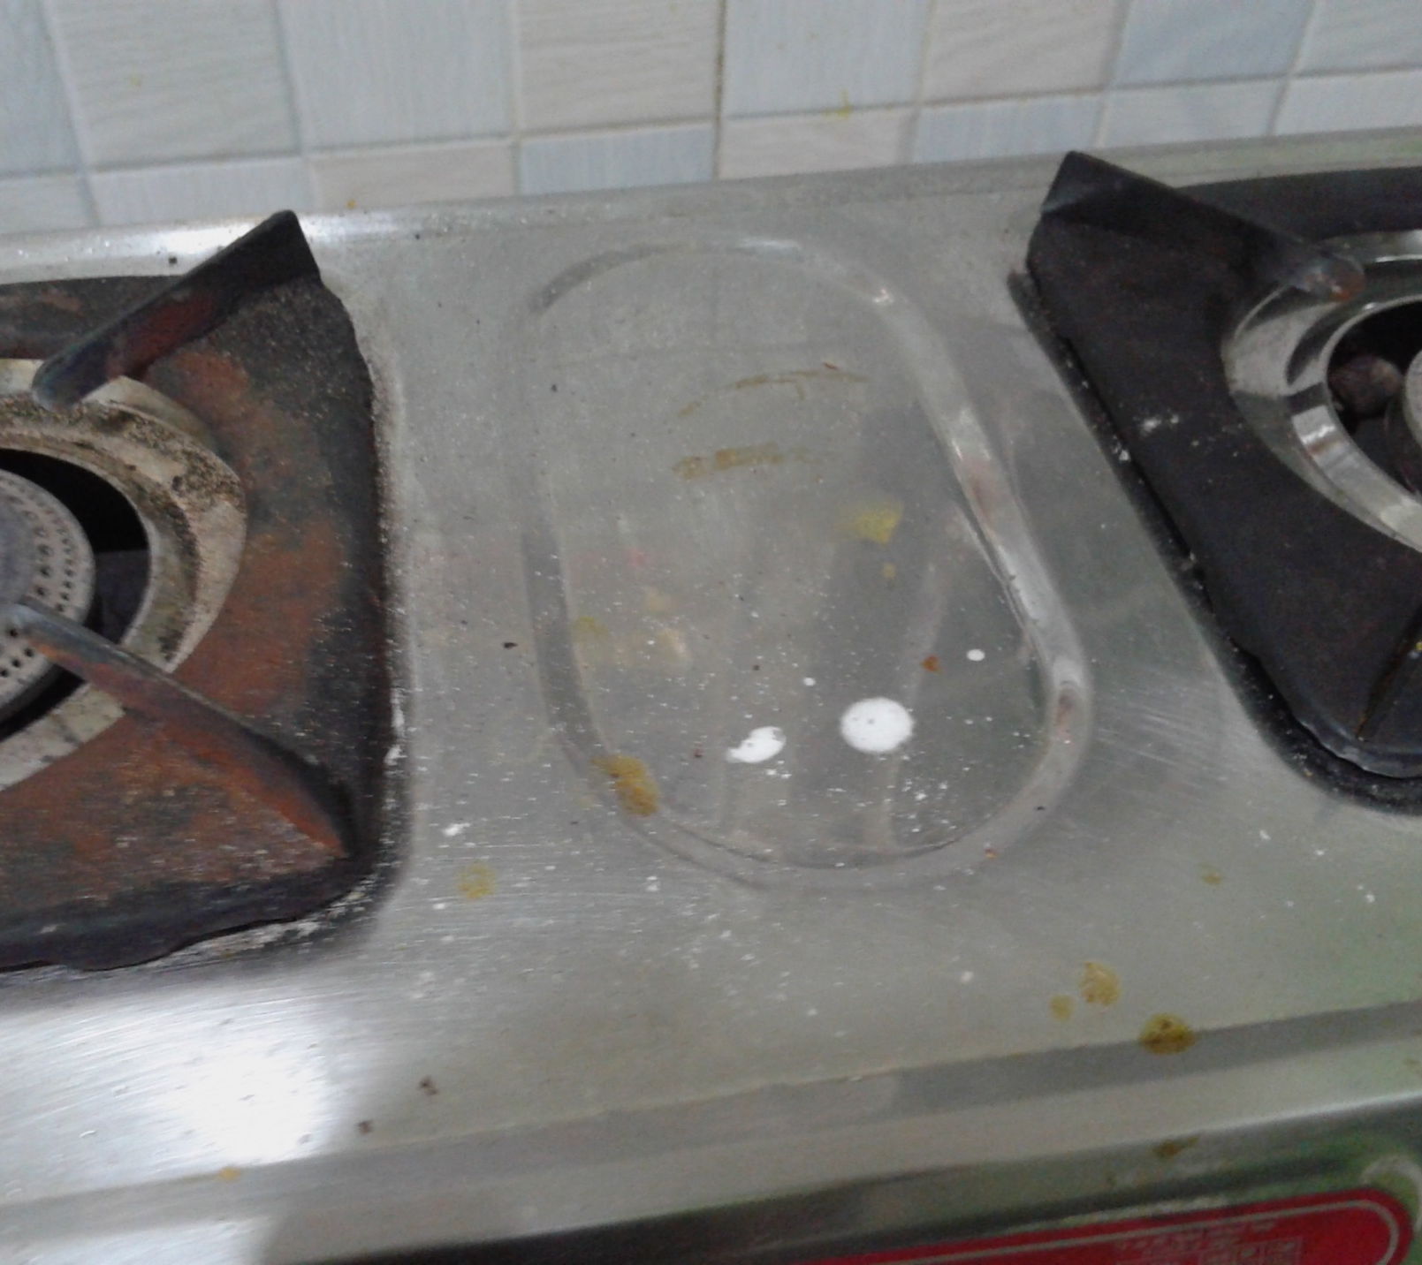
To be cleaned
Stove

Slide 29
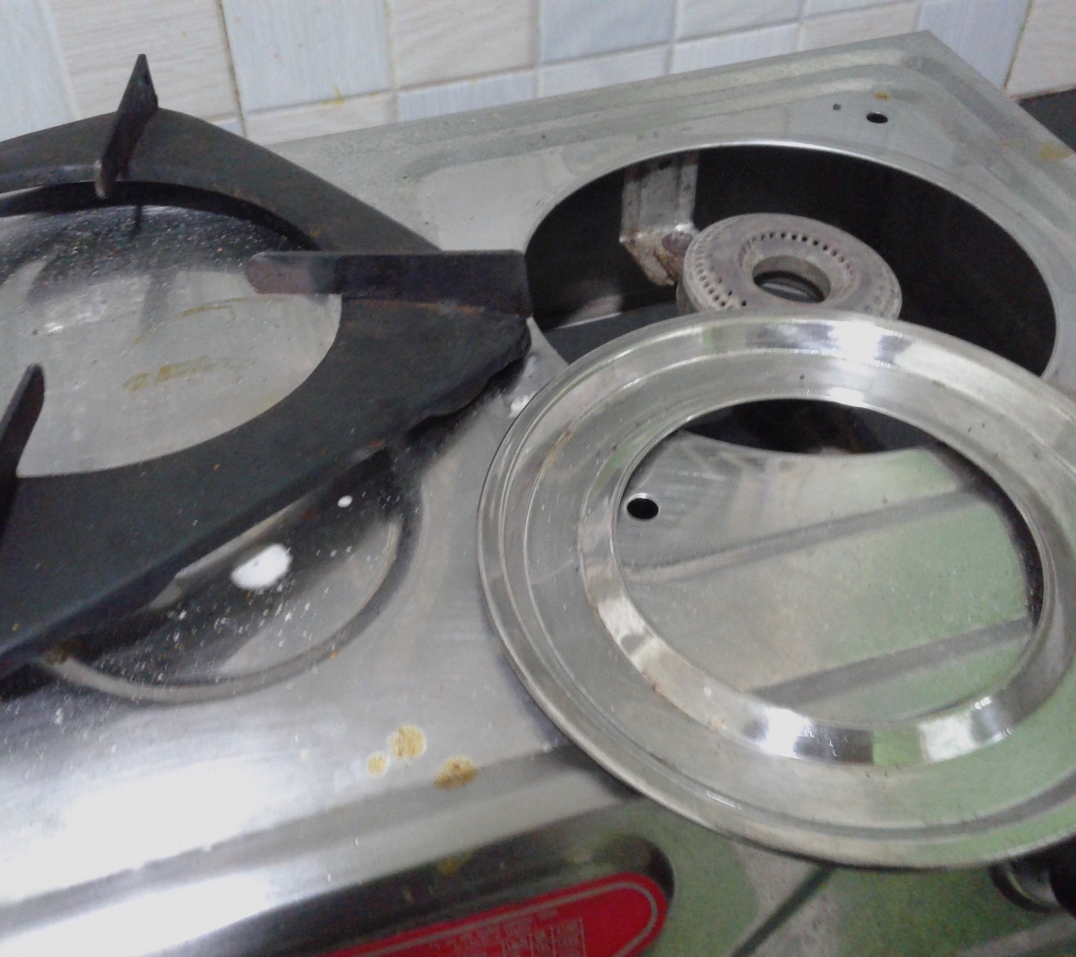
To be cleaned
Remove and clean

Slide 30
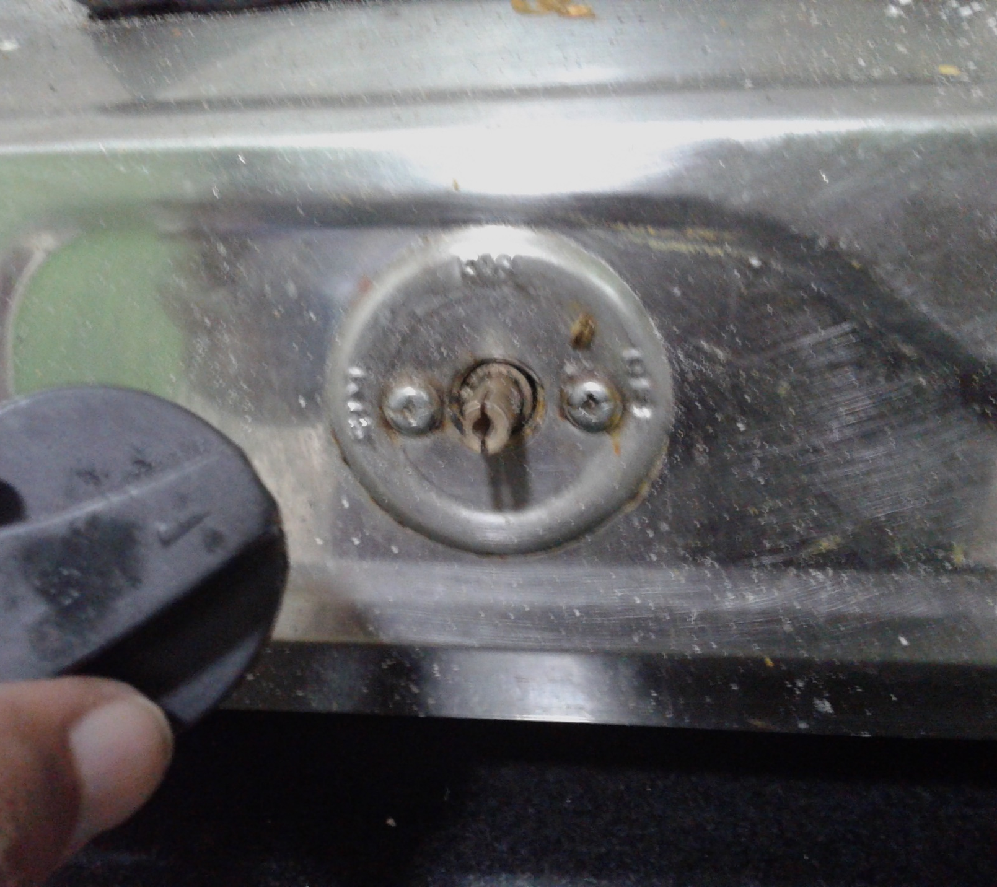
To be cleaned
Knob

Slide 31
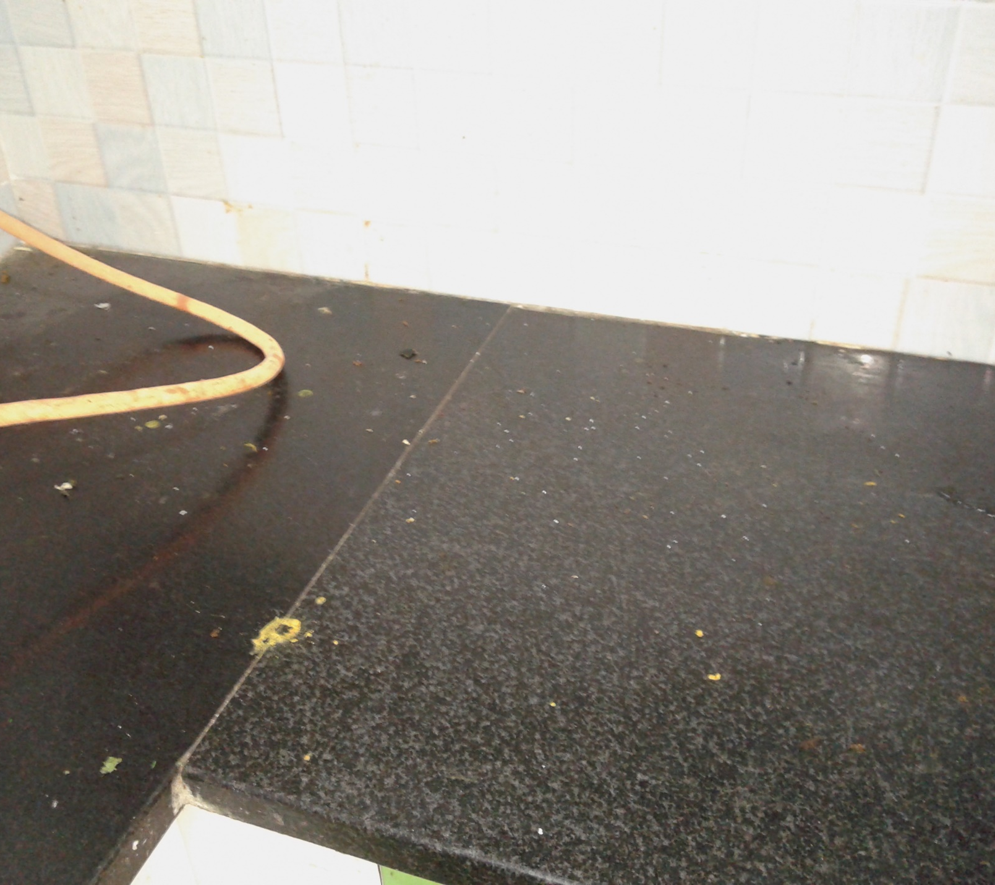
To be cleaned
Kitchen Marble slab

Slide 32
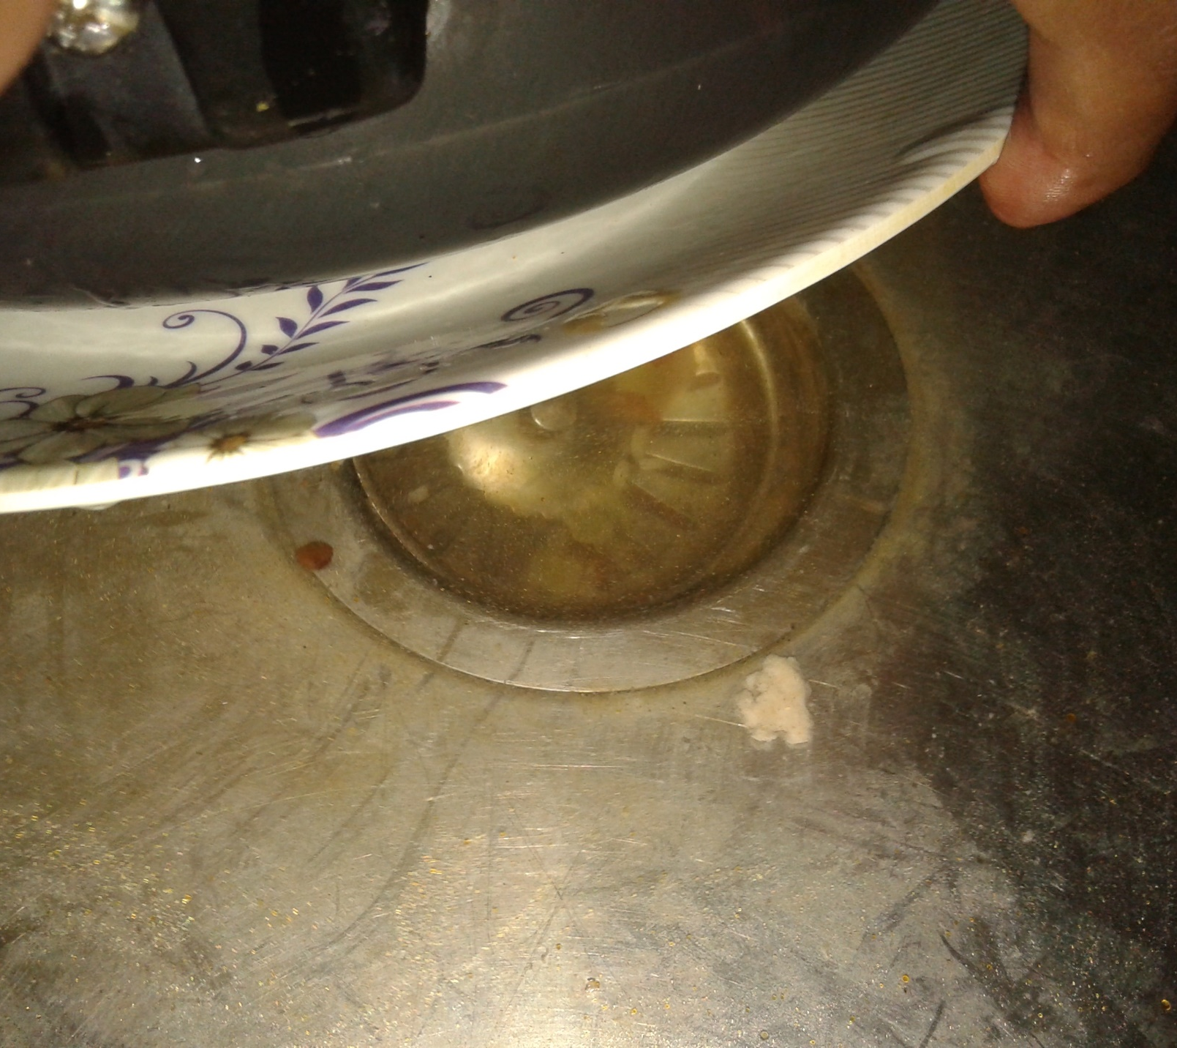
To be cleaned
Sink hole

Slide 33
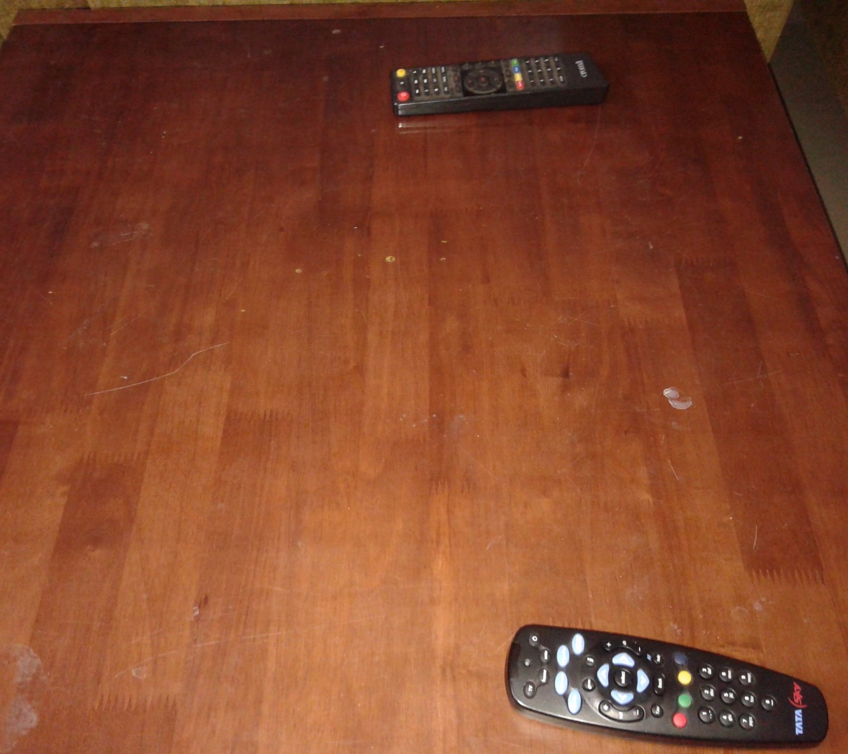
To be cleaned
Table

Slide 34
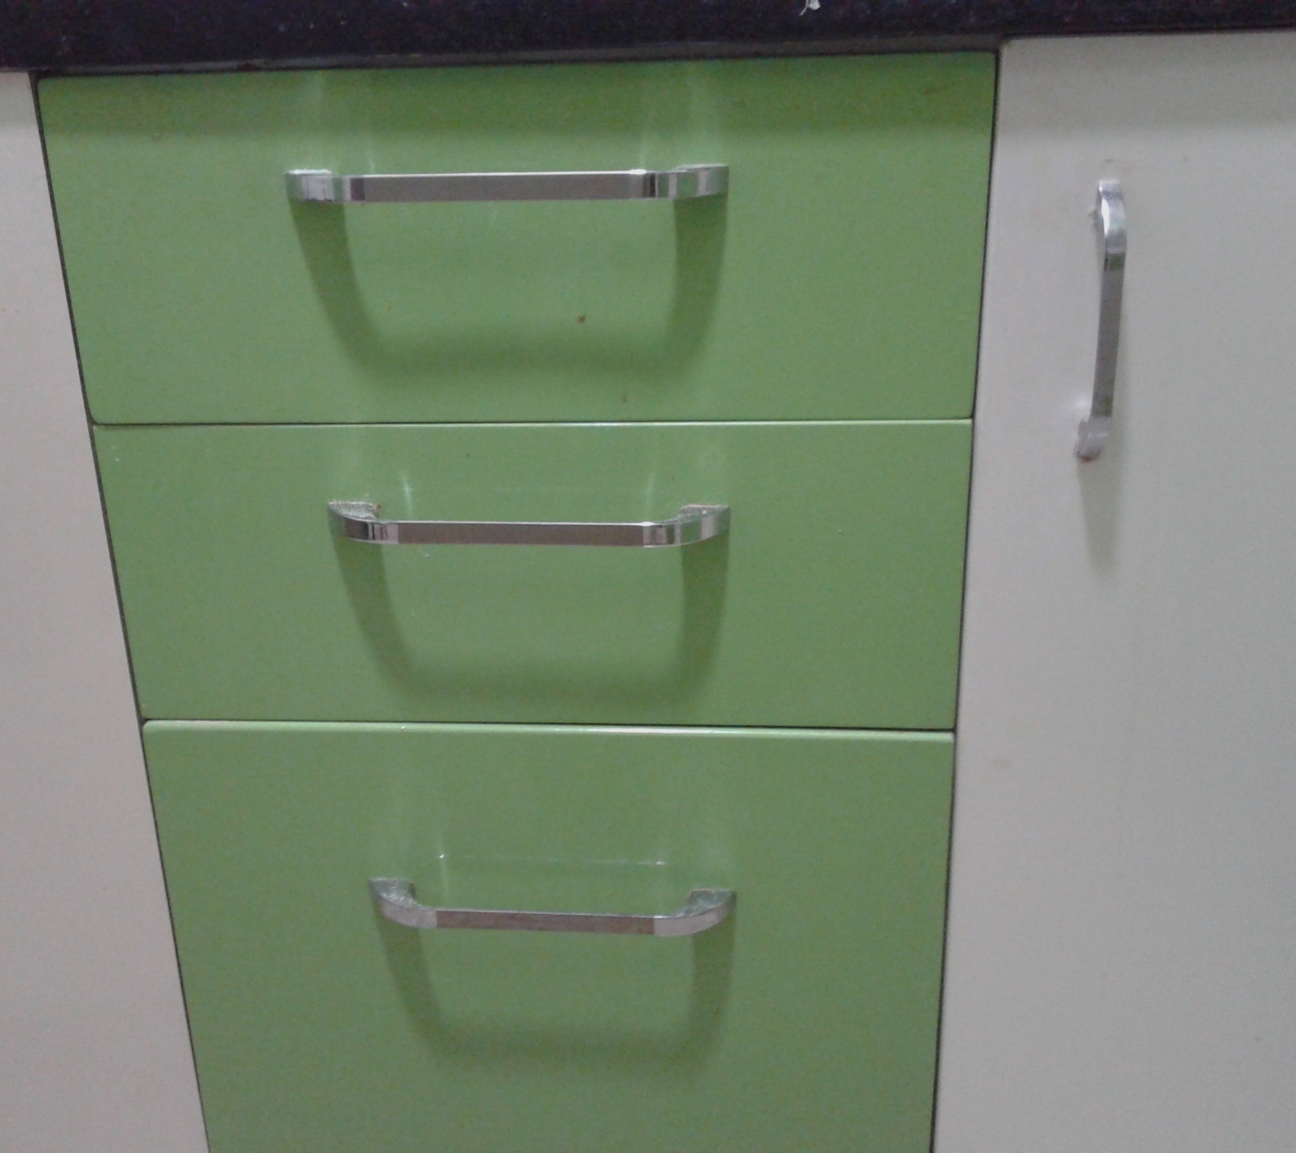
To be cleaned

Slide 35
CLEANLINESS & HYGIENE-GENERAL
So that we don’t just live, we stay healthy…

Slide 36
Cleanliness & Hygiene-General
Fridge-once a month
Sofa and table-throw any wrappers/covers etc. in the dry bin
TV-once a month
Everyone has to contribute
Once every month
Estimated time: 10 minutes max.
Roster to be maintained
Automated reminder mails to be sent.

Slide 37
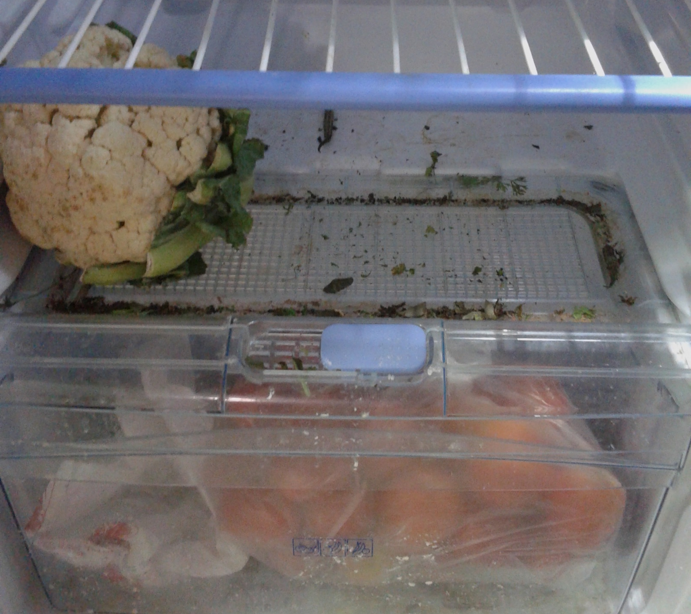
To be cleaned
Fridge

Slide 38
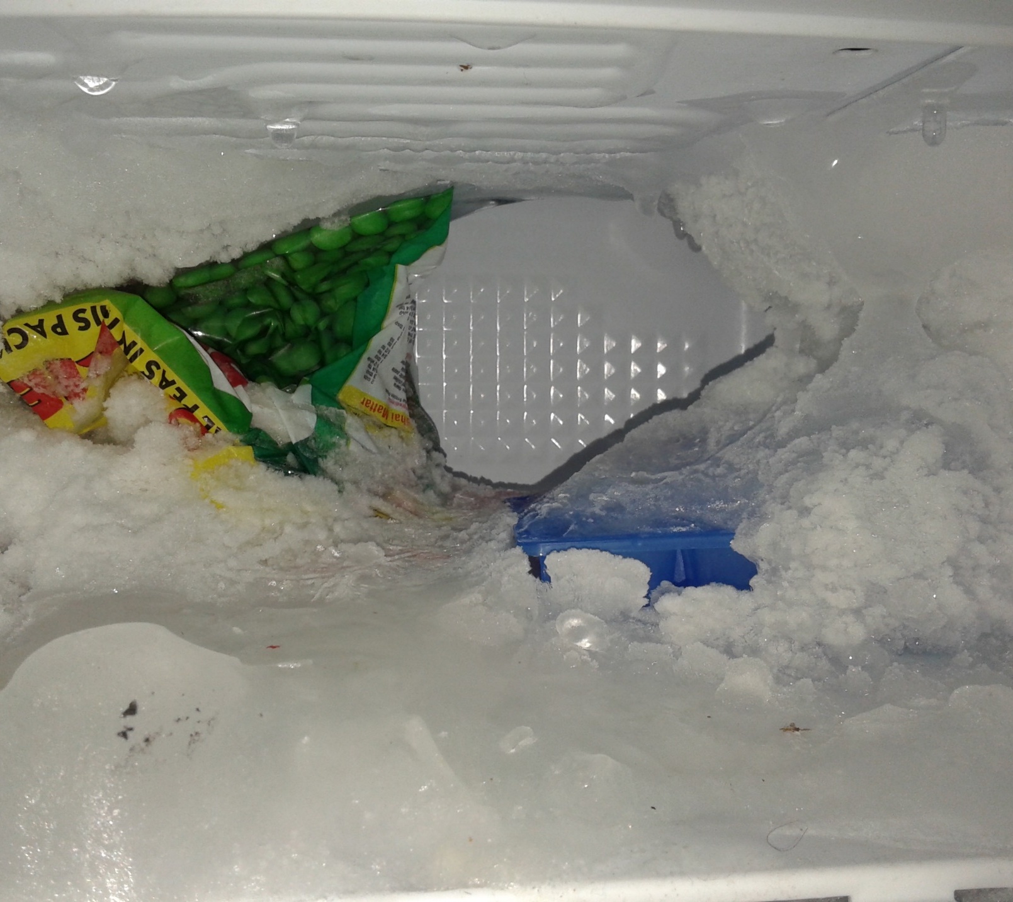
Fridger too!
Green matter since 1843!!

Slide 39
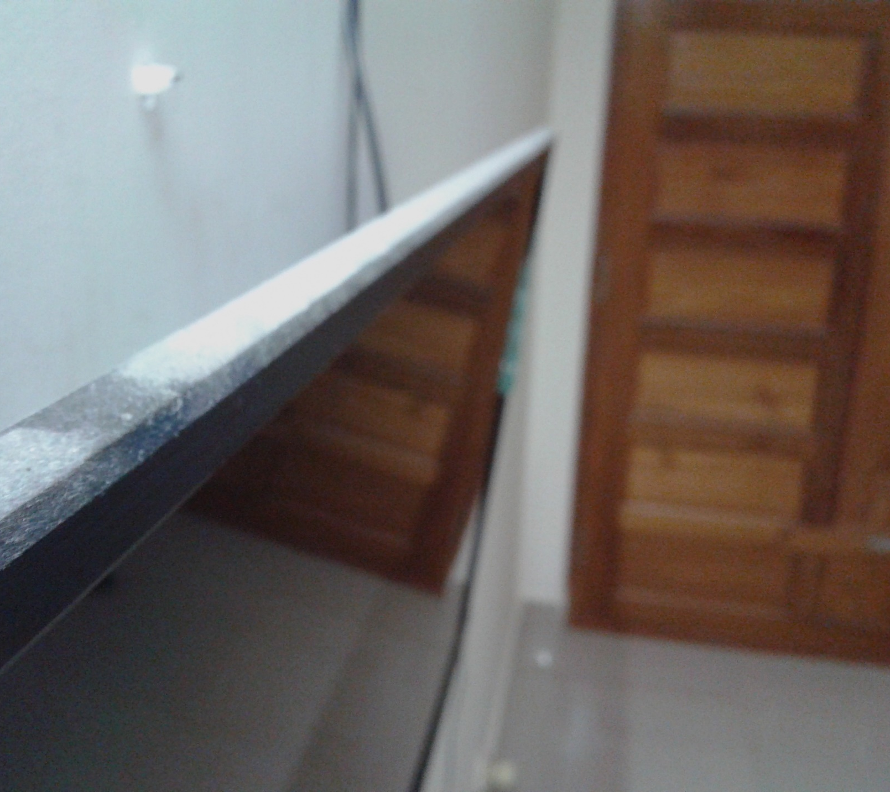
To be cleaned
TV

Slide 40
To be cleaned
Table

Slide 41
INTERNET
So that all may remain connected…

Slide 42
Internet
Unlimited use by everyone
Be considerate in use.
Browsing has more importance than downloading,
So download preferably in low demand times-afternoon and late night/early morning.
Else others might face difficulty in browsing also!!!
Limit download speed in download managers if downloading in high demand times.
Plans and bill payments to be decided mutually

Slide 43
WATER
So that all may remain hydrated…

Slide 44
Water
Use judiciously
Call can dealer when water level is low
If not paying, post in group so that the next time the delivery guy will be paid accordingly
Ask the delivery guy to open the seal

Slide 45
ELECTRICITY
So that our life goes on…

Slide 46
Electricity
Use judiciously
Switch off appliances when not in use.
Switch off lights/fans when leaving the room
Switch off all lights in the common area(hall/kitchen) during night time.
Switch off TV, Router when not in use.
Switch off Washing Machine after washing is complete.

Slide 47
GAS
So that we may cook…

Slide 48
Gas
Use judiciously
Turn knob off when not in use.
Call delivery guy when gas is over
Don’t play around with gas pipe
Bill payment -> mutually decided

Slide 49
Open House Discussion(OHD)
9pm, Last Monday of every Month

Slide 50
Open House Discussion
9pm, Last Monday of every Month
Discuss any pending issues/problems
Communicate with each other

Slide 51
Pollution
Reducing pollution

Slide 52
Pollution-Sound pollution
Be considerate.
Use optimum sound levels on TV, Phone, Laptop, Speakers etc. so that others may not be disturbed

Slide 53
Pollution-Air pollution
Be considerate
Smoke, but not in public(away from non-smokers) areas.

Slide 54
Pollution-Light pollution
Be considerate
Turn off light when not in use
Reduce brightness if possible

Slide 55
Document available at: https://github.com/Blacky001/s3-vajravista-Home-Management-System
Thank You.

